Slide 1
Distance Vector Routing Algorithm

Slide 2
Each router maintain a table with the best known distance to each destination and which line to use to get there. Tables updated by exchanging information with the neighbors.

Slide 3
Facts
Each router periodically shares its knowledge about the entire network with its neighbours
Each router has a table(vector) with information about network. These tables are updated by exchanging information with the immediate neighbours.
It is also known as Bellman-Ford or Ford-Fulkerson Algorithm

Slide 4
Assumption
Router is assumed to know the ‘‘distance’’ to each of its neighbours

Slide 5
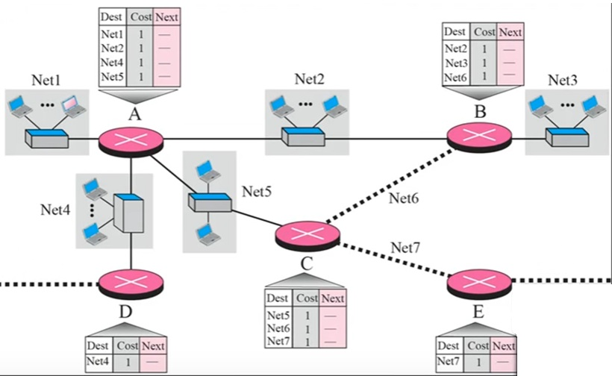

Slide 6
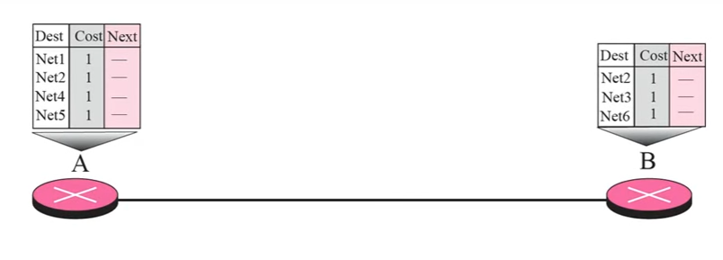
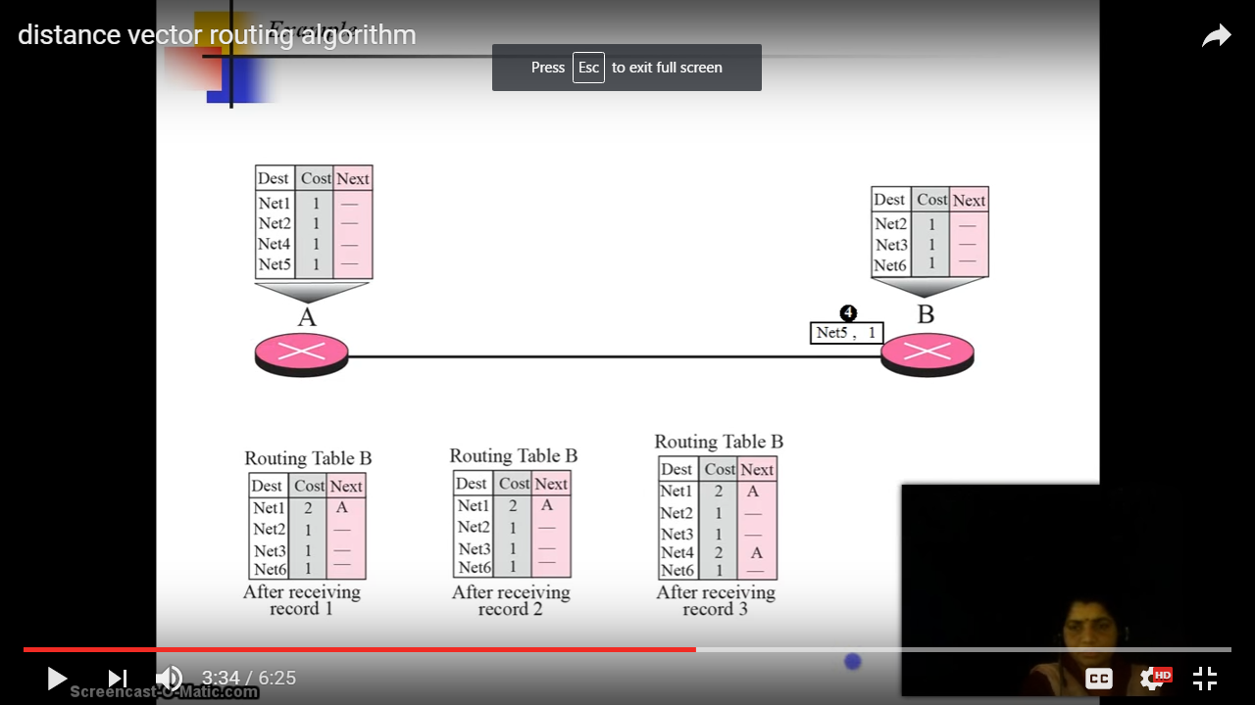
Dest | Cost | Next
Net1 | 2 | A
Net2 | 1 | -
Net3 | 1 | -
Net4 | 2 | A
Net5 | 2 | A
Net6 | 1 | -

Slide 7
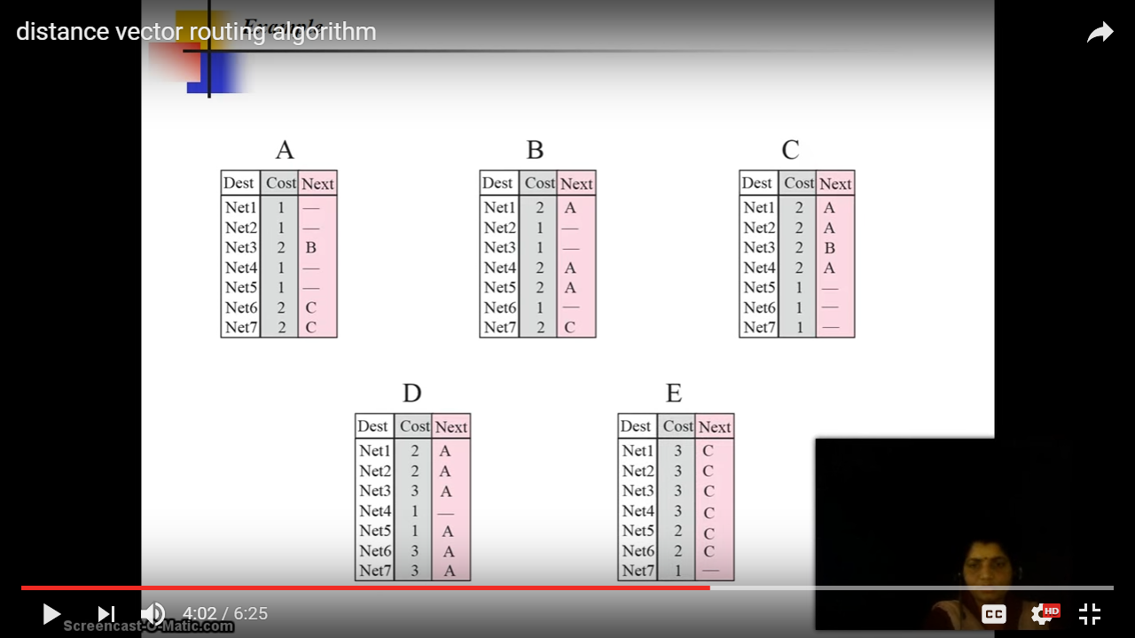

Slide 8
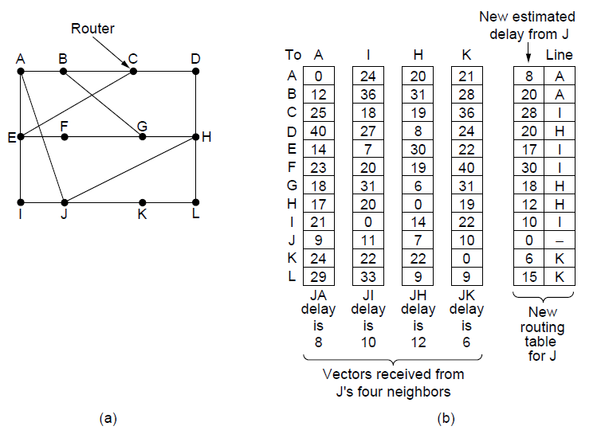
Distance Vector Routing
Aim – J to G
(a) network (b) Input from A, I, H, K, and the new routing table for J.

Slide 9
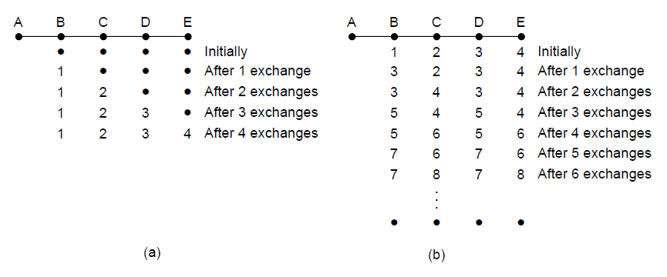
The Count-to-Infinity Problem
A is down
A is up (Good news)
A-B exchange
B-C exchange
C-D exchange
D-E exchange

Slide 10
All connected to A
A goes down
B has no path to A
B gets data to reach A via C
But C takes to A via B

